Slide 1

Hardhat Enterprises
Trimester 1, 2023

Slide 2
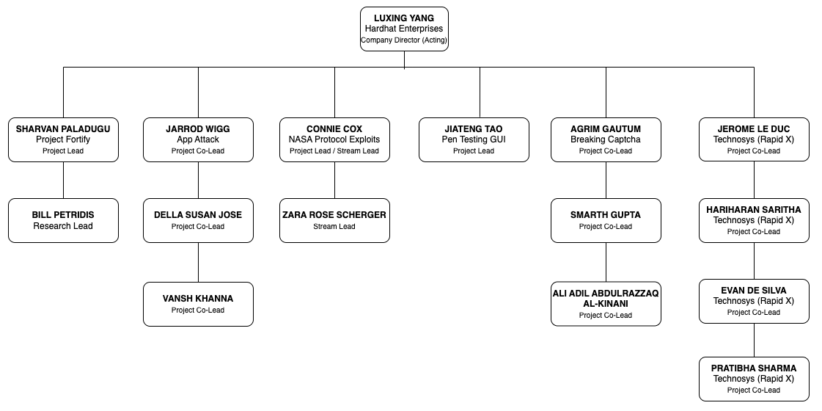
Company Mission
“To create cyber tools that empower White-hat operations in terms of supporting the protection of / defence against vulnerabilities and attacks”
Skillset, learned and applied in Hardhat Enterprises will better prepare you for opportunities that come up in Cybersecurity and other aligned sectors.
Company Leadership
Hardhat Enterprises
Notes:
Good morning everyone. Today, we are here to present to you our company's mission and our projects on which we will be working upon this trimester. Our company, Hardhat Enterprises, strives to create cyber tools that empower white-hat operations in terms of supporting the protection of and defense against vulnerabilities and attacks. We believe that the skill set learned and applied in our company will better prepare our employees for opportunities that come up in cybersecurity and other aligned sectors.

Slide 3
Project:
Trimester Deliverables:
Identify new vulnerabilities within our systems and validate existing vulnerabilities to ensure they have been adequately addressed.
Hosting the test environment in Virtual Machines (VMs) for now
Assess the viability of a potential migration to GCP more efficient testing.
Identify potential applications (Discussions for feasibility of testing Gopher Industries applications has been started) that can be used for attacks, besides Ontrack.
Strengthen cybersecurity defences to safeguard our systems and data against potential threats.
App Attack
Hardhat Enterprises
Notes:
Our first project is "AppAttack." The main goal of this project is to identify new vulnerabilities within our systems and validate existing vulnerabilities to ensure they have been adequately addressed. We will host the test environment in virtual machines (VMs) for now. Additionally, we will assess the viability of a potential migration to GCP for more efficient testing. We will also identify potential applications that can be used for attacks besides Ontrack. Lastly, we aim to strengthen cybersecurity defenses to safeguard our systems and data against potential threats.

Slide 4
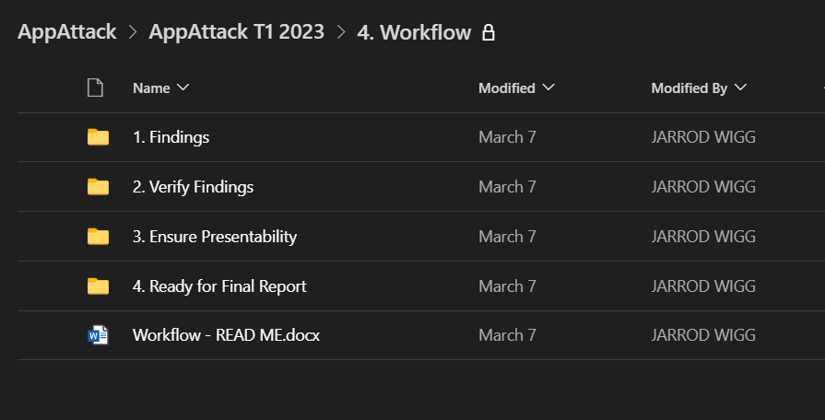
Project:
Project plan: Workflow x Trello
App Attack
Hardhat Enterprises
Notes:
For the workflow of this project, we will be using our own workflow process as shown with the Trello, and we will show you the screenshots of our these to give you a better idea of how we are managing the project.

Slide 5
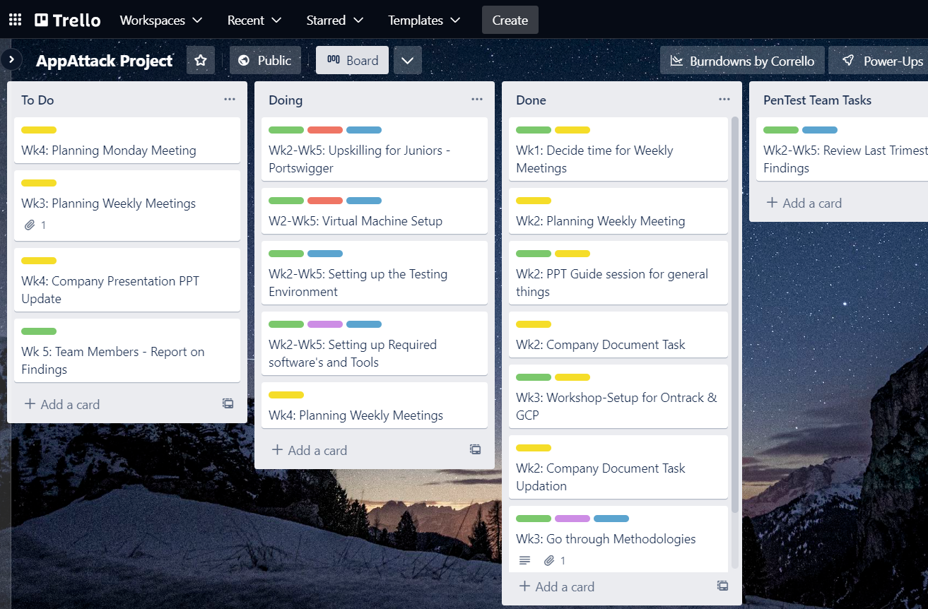
Project:
Project plan: Workflow x Trello
App Attack
Hardhat Enterprises
Notes:
For the workflow of this project, we will be using our own workflow process as shown with the Trello, and we will show you the screenshots of our these to give you a better idea of how we are managing the project.

Slide 6
Project:
Team Members & Roles:
Name | Role
Jarrod Wigg | App Attack Co-Lead
Della Susan Jose | App Attack Co-Lead
Vansh Khanna | App Attack Co-Lead
Akshay Deodare | Pen testing Team Lead
Josiah Paul Walker | Pen testing Team Lead
Erik Wing Hung Wu | SCR Team Lead
Jonah Blundell | Penetration Tester
Chloe Brushfield | Penetration Tester
Fiona Akhounova | Penetration Tester
Vijay Srinivasan | Penetration Tester
Louis Sloper | Penetration Tester
Harjinder Jarewal | Penetration Tester
John Patrick Thomas | Penetration Tester
Liam Barrow | Penetration Tester
Suntosh Mudaliar | Penetration Tester
Phil Barbosa Manfrinato | Penetration Tester
Davies Mudavanhu | Penetration Tester
Angad Gandhi | Penetration Tester
Syed Huzaifa Hashsham | Penetration Tester
Matthew Shiroodi | Penetration Tester
Name | Role
Cooper Winser | Penetration Tester
Beau Williams | Penetration Tester
Dilushan Gunasekara | Penetration Tester
Prashant Vijay Patil | Penetration Tester
Karl Ivan Aquino | Penetration Tester
Michael Johnson | Penetration Tester
Pavankumar Andaneppa Yarlagatti | Penetration Tester
Nicolai Domini A. Mahinay | Penetration Tester
Mohammed Abdul Muqeet | Penetration Tester
Quinn Curtis | Secure Code Reviewer
Abhivirdh Purushothaman | Secure Code Reviewer
Harrison Relf | Secure Code Reviewer
Sandy Josipovic | Secure Code Reviewer
Rahanth Alagesan | Secure Code Reviewer
Rajvikram Rajendran | Secure Code Reviewer
Karl Josef Labsan | Secure Code Reviewer
Qanita Nadhirazka | Secure Code Reviewer
Geoffrey Kit-Son Shek | Secure Code Reviewer
Isaac kimaiyo koech | Secure Code Reviewer
Asseel Mala | Secure Code Reviewer
App Attack
Hardhat Enterprises
Notes:
Lastly, would be the team member and roles list of this project. Now passing the mic for next project.

Slide 7
Project:
Trimester Deliverables:
Conducting extensive research and development to solve CAPTCHA problems.
Collaborating with AI developers to create a more secure and user-friendly reCAPTCHA.
Rigorous testing and validation of models for accuracy, reliability, and effectiveness.
Developing a secure and user-friendly reCAPTCHA using cryptography, programming, AI, and machine learning.
Building a website for end-users to upload reCAPTCHA challenges in various formats and check their security level.
Breaking Captcha
Hardhat Enterprises

Slide 8
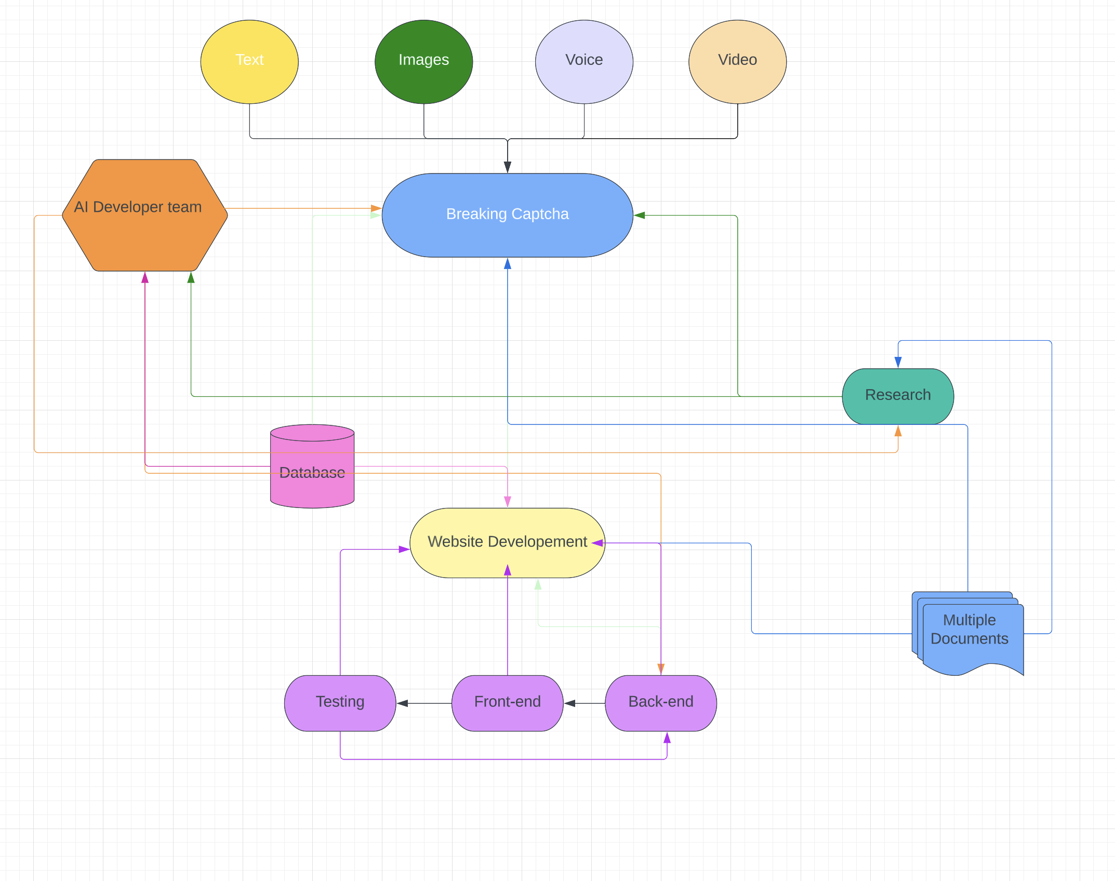
Project:
Project plan:
Breaking Captcha
Hardhat Enterprises

Slide 9
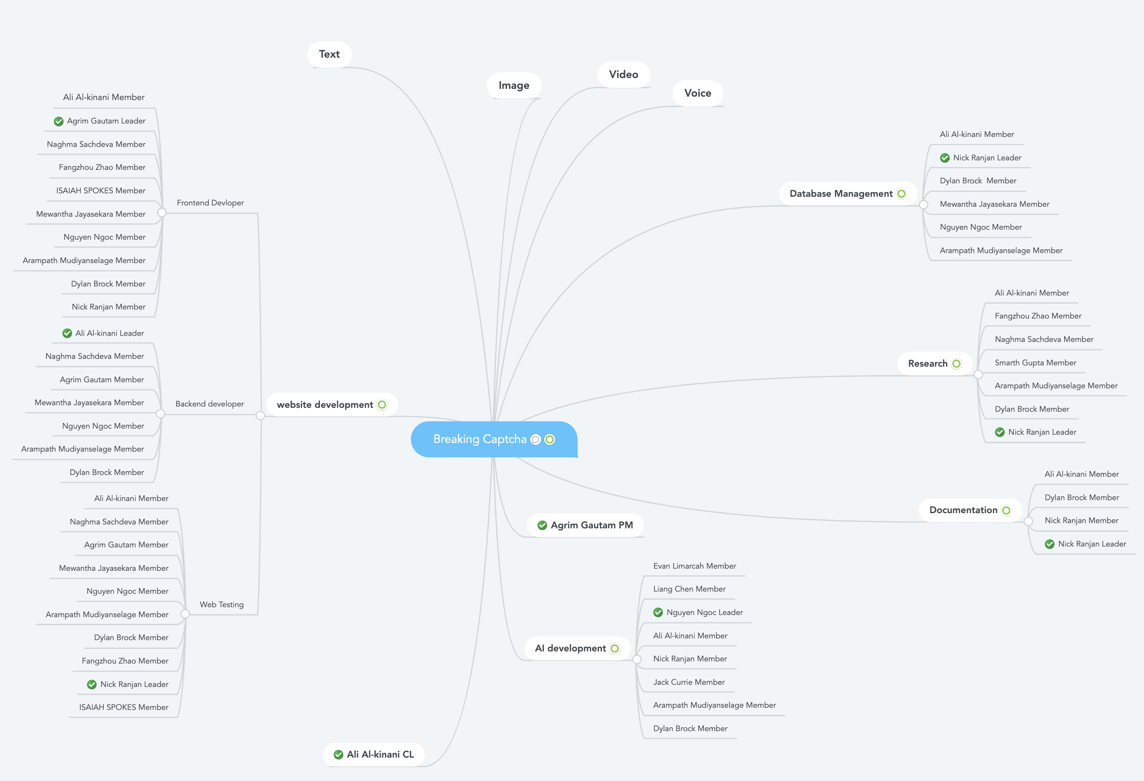
Project:
Team Members & Roles:
Breaking Captcha
Hardhat Enterprises

Slide 10
Project:
Fortify's Trimester Deliverables:
Build an MVP showcasing a user case for the organization and volunteer.
Improve wireframe and web design to include additional functionality.
Develop and further research to be able to provide a framework, technical solutions, Cybersecurity educational material for both the volunteers and organisations and standard operating procedure includes:
Creation of content that will guide and educate both Cyber volunteers and organisation
Provide technical solutions for Cyber improvements based on the Essential 8 for example how to best implement MFA and available options.
Research into the process for cybersecurity posture and maturity improvement for organisations and provided the process of consultancy for our volunteers for same.
Fortify x Technosys
Hardhat Enterprises

Slide 11
Project:
TechnoSys' Trimester Deliverables
Develop scenario-based playbooks for client and partner interactions and communications.
Create education learning programs to upskill project juniors and cyber students.
Provide upskill pathways for career choices and recommend industry-recognized certifications.
Recommend resources for Certified in Cybersecurity (CC).
Develop communication upskill workshops program with step-by-step checklists for creating presentations on cybersecurity recommendations for clients.
Develop a questionnaire to understand clients' cybersecurity awareness training programs.
Create a framework for gathering, analysing, and presenting threat intelligence.
Fortify x Technosys
Hardhat Enterprises

Slide 12
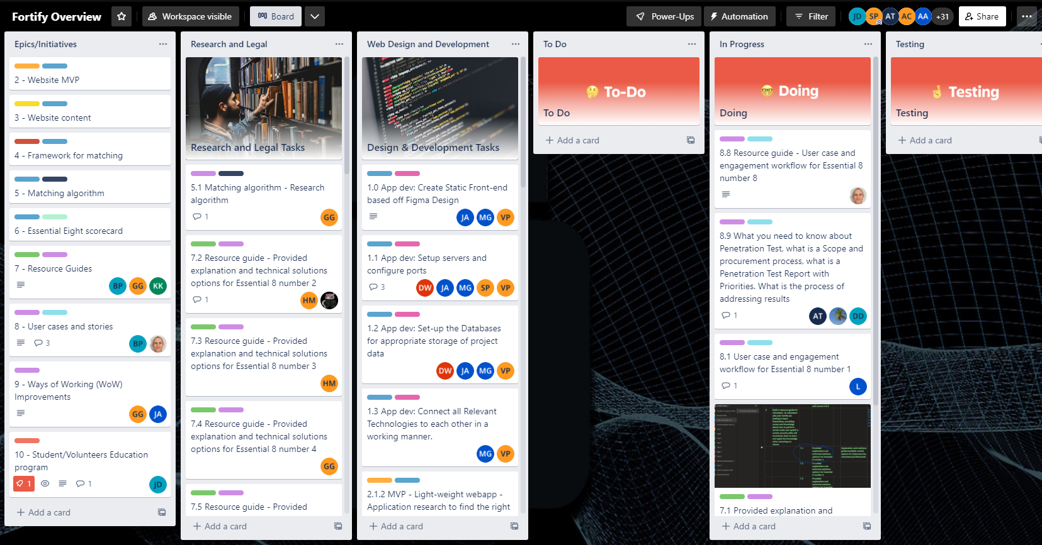
Project:
Project plan:
Fortify x
Technosys
Hardhat Enterprises

Slide 13
Project:
Team Members & Roles:
Name | Role
Shravan Kumar Paladugu | Project Lead
Bill Petridis | Team Lead (Research)
Danielle Dimakis | Team Member
Manav Lath | Team Member
Viraj Kalpeshbhai Prajapati | Team Member
Abigail Chong | Team Member
Sri Varshini Reddy | Team Member
Daniel Stanning | Team Member
Kevin Kidd | Team Member
David Wang | Team Member
George Gkoumas | Team Member
Chi Wai Lewis Yau | Team Member
Aayush Talwar | Team Member
Nadia Maharani Azhari | Team Member
Meet Kishorbhai Gadhiya | Team Lead (Development)
Archankumar Pareshbhai Patel | Team Member
Mahidhar Reddy Nalamaru | Team Member
Tom Watt | Team Member
Samruddhi Pradeep Patil | Team Member
Hassan Madni | Team Member
Bruce Roberts | Team Member
Julia Axelrod | Team Member
Holly Jane Collett | Team Member
Anudeep Chengalvala | Team Member
Tom Edmondson | Team Member
Fortify x Technosys
Name | Role
Jerome Le Duc | TechSys activities Lead
Hariharan Saritha | Team Member
Evan De Silva | Team Member
Pratibha Sharma | Team Member
Bryan Gunawan | Team Member
Hardhat Enterprises

Slide 14
Project:
Trimester Deliverables:
For the following streams:
Static Stream:
Vulnerability Reports including observations and remediation recommendations.
Dynamic Stream:
Fuzzing Scripts for the following protocols; CFDP, BP, cFS.
Vulnerability Reports.
Experiment Finding Reports.
Attack Scenarios.
Project Leadership / Contributing Members:
Company Handbook on GitHub.
Updated Training Resources.
Various Frameworks for vulnerability identification and reporting
NASA Exploits
Hardhat Enterprises
Notes:
NASA Exploits looks at satellite network communications and has two primary goals:
To analyse the NASA Protocols and
Expose and close vulnerabilities
We plan to achieve our goals through the delivery of:
Research analysis documentation
Vulnerability exploit simulation
Vulnerability remediation recommendation(s)
If you have a passion for:
Code analysis
C & Python programming
Linux (Ubuntu)
Networking

Slide 15
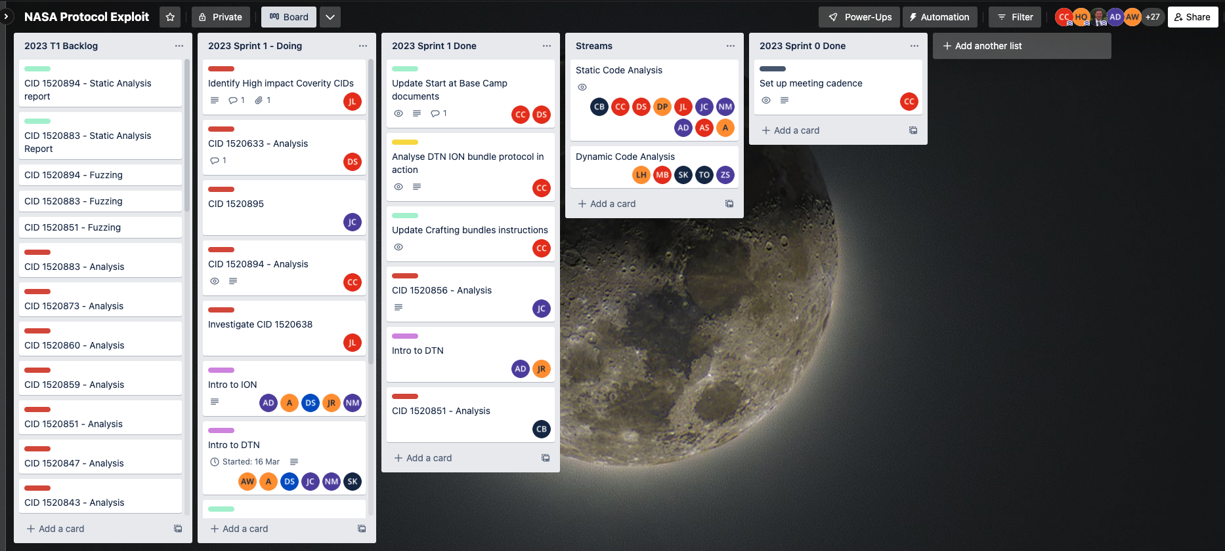
Project:
Project plan:
NASA Exploits
Hardhat Enterprises
Notes:
NASA Exploits looks at satellite network communications and has two primary goals:
To analyse the NASA Protocols and
Expose and close vulnerabilities
We plan to achieve our goals through the delivery of:
Research analysis documentation
Vulnerability exploit simulation
Vulnerability remediation recommendation(s)
If you have a passion for:
Code analysis
C & Python programming
Linux (Ubuntu)
Networking

Slide 16
Project:
Team Members & Roles:
Name | Role
Connie Cox | Project Lead
Zara Rose Scherger | Stream Lead
Tristen Clifton | Stream Lead
Jesse Ludeman | Stream Lead
Adharshaan Devaraj | Vulnerability Analyst / Researcher
Amber Smith | Vulnerability Analyst / Researcher
Anthony Scantsonihas | Vulnerability Analyst / Researcher
Callum Jozef Besley | Vulnerability Analyst / Researcher
Chi Bang Nguyen | Vulnerability Analyst / Researcher
Damon Willmott | Vulnerability Analyst / Researcher
Darshil Shah | Vulnerability Analyst / Researcher
Dean Scanlon | Vulnerability Analyst / Researcher
Druween Perera | Vulnerability Analyst / Researcher
Fortune Chirowodza | Vulnerability Analyst / Researcher
Gabriella Roslan | Vulnerability Analyst / Researcher
Jamil Rizkallah | Vulnerability Analyst / Researcher
John-Eddie Cubis | Vulnerability Analyst / Researcher
Kawthar Hassanaddie | Vulnerability Analyst / Researcher
Lewis Hobbs | Vulnerability Analyst / Researcher
Melissa Barsenbach | Vulnerability Analyst / Researcher
Moe Kyaw | Vulnerability Analyst / Researcher
Nicholas Mag | Vulnerability Analyst / Researcher
Sadeepa Kaushal Meegahawaththage | Vulnerability Analyst / Researcher
Thomas Frampton | Vulnerability Analyst / Researcher
Tom Oberli | Vulnerability Analyst / Researcher
NASA Exploits
Hardhat Enterprises
Notes:
NASA Exploits looks at satellite network communications and has two primary goals:
To analyse the NASA Protocols and
Expose and close vulnerabilities
We plan to achieve our goals through the delivery of:
Research analysis documentation
Vulnerability exploit simulation
Vulnerability remediation recommendation(s)
If you have a passion for:
Code analysis
C & Python programming
Linux (Ubuntu)
Networking

Slide 17
Project:
Trimester Deliverables:
1.Exploit development
Develop new attack vectors or penetration testing tools based on recent CVE disclosures, zero-day vulnerabilities or reconnaissance developments.
Create an MVP for AI based pen-testing functionality
2.Function validation
Validate function with three attack cases on HackTheBox with walkthrough videos.
3.Cloud migration
Build an MVP for PT-GUI on the Google Cloud Platform for cloud migration.
Penetration Testing GUI
Hardhat Enterprises
Notes:
Our final project is "Penetration Testing GUI."
The main goal of this project is to exploit development using the new attack vectors or penetration testing tools based on recent CVE disclosures, zero-day vulnerabilities, or reconnaissance developments. We will further also create an MVP for AI-based pen-testing functionality.
Moreover, we plan to validate the function with three attack cases on HackTheBox with walkthrough videos. Lastly, we will build an MVP for PT-GUI on the Google Cloud Platform for cloud migration.

Slide 18
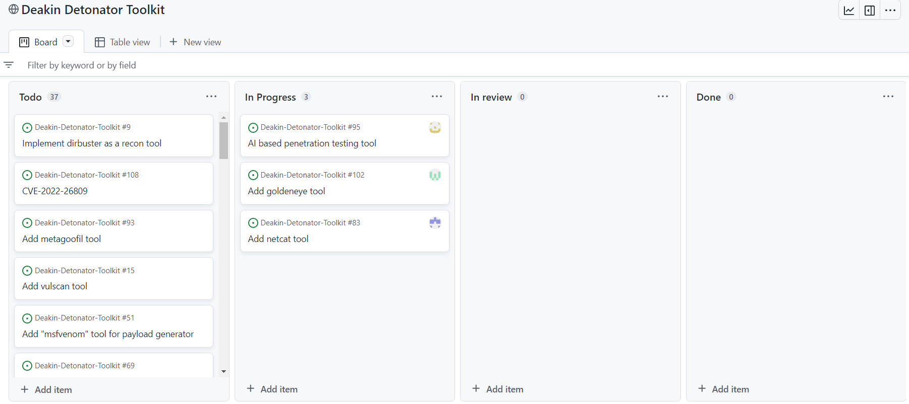
Project:
Project plan:
Penetration Testing GUI
Hardhat Enterprises

Slide 19
Project:
Team Members & Roles:
Penetration Testing GUI
Name | Role
Jiateng Tao | Project Lead
Pushkar Goel | Stream Lead
Mitchell Boyd | Security Analyst
Hamza Ismail | Secuirty Analyst
Ivan Au-Yeung | Security Analyst/GUI dev
Steven Shao | Security Analyst/GUI dev
Cameron Crabb | Security Analyst
Gerard Araullo | GUI developer/Securiy Analyst
Luke Smith | Security Analyst/GUI dev
Yiheng Liu | Security Analyst/GUI dev
Ashwin kumar | Secuirty Analyst
Laasya Yalamanchili | Security Analyst
Karl Labsan | Security Analyst
Kyle Durst | Security Analyst/GUI dev
Pavankumar Andaneppa Yarlagatti | Security Analyst
Kunal Bachhal | Security Analyst
Anurag Verma | Security Analyst
Caitlin Grainger | GUI developer/Securiy Analyst
Mohammed Sharf Uddin | Security Analyst/GUI dev
Hardhat Enterprises

Slide 20
Q & A?
Thank you!
Hardhat Enterprises
Notes:
In conclusion, we believe that our company's mission and projects reflect our dedication to cybersecurity and our desire to create tools that support the protection and defense of vulnerabilities and attacks. Our projects, showcase our company's commitment to innovating and pushing the boundaries of cybersecurity. Thank you for listening, and we are open to any questions you may have.
If there are no more questions for now, Let's just wrap it up then. If you have any queries regarding our projects in future, please refer to our company leadership structure, and our leadership team will be happy to assist you.

